Slide 1

ESG Training For the new requirement of HKEX ESG in 2020 Hauman Yeung Ascent Partners

Slide 2
Minor issues
Shortening the deadline for publication of ESG reports, with a revised timeframe of within five months after the financial year-end
Printed ESG report not required (unless responding to shareholders’ specific request), with a notification of online publication

Slide 3
Board responsibility
Old version – two paragraphs describe the responsibility of the board
New version – only on sentence “ The board has overall responsibility for an issuer’s ESG strategy and reporting”

Slide 4
Board statement
A statement from the board containing the following elements:
a disclosure of the board’s oversight of ESG issues;
the board’s ESG management approach and strategy, including the process used to evaluate, priorities and manage material ESG-related issues (including risks to the issuer’s business); and
how the board reviews progress made against ESG-related goals and targets with an explanation of how they relate to the issuers’ business

Slide 5
Emission KPIs
Specified the requirement of scope 1 and scope 2 disclosure, but haven’t mentioned about scope 3
Description of emission target set and steps taken to achieve them

Slide 6
Use of resources KPIs
Description of resources use efficiency and sourcing
Set targets of efficiency and step taken to achieve them

Slide 7
Climate Change

Slide 8
Background －Climate change
In 1997, 192 countries in the world signed the Kyoto Protocol, aimed to reduce the emission by 5.2% in 2008 compare to 1992.
Those developed countries have to undertake reduction responsibility base on the ground that they’ve been intensively emitting for more that 200 year. Developing countries got subsidies on mitigating emission.
UN has unified the emission calculation method

Slide 9
Reason for failure
US has signed the protocol under Clinton government. But George Bush refused to ratify the protocol after his presidency.
In the year of 1997, no one could predict the un-imaginary speed of economic development of China. In fact China has take over US in 2007 to became the largest emission country in the world.

Slide 10
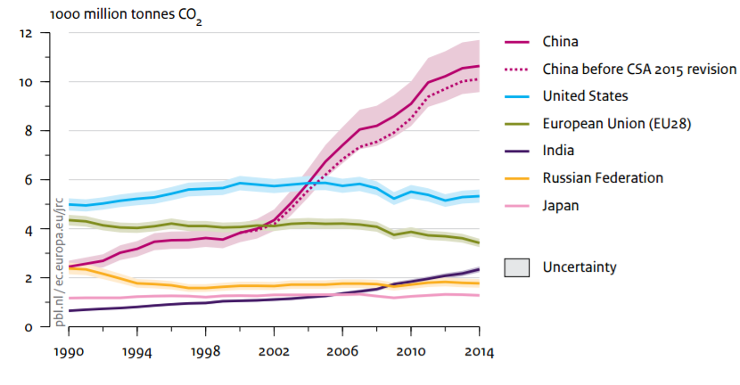
World emission

Slide 11
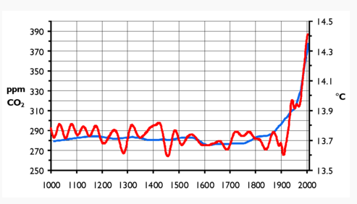
Climate change

Slide 12
The Paris Agreement
Central aim is to keep a global temperature rise this century well below 2 degrees Celsius above pre-industrial levels and to pursue efforts to limit the temperature increase even further to 1.5 degrees Celsius
China has vowed to peak carbon emission by 2030
US has committed to cut emissions 26-28% below 2005 levels by 2025
A World Investment Forum was held on 2014 in Geneva to explore how the world’s exchange can develop sustainable reporting in response to the Global warming

Slide 13
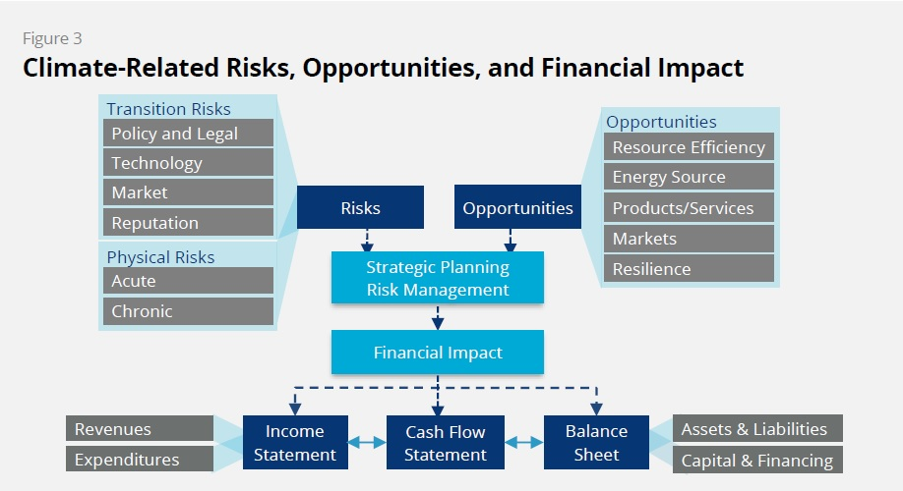
TCFD

Slide 14
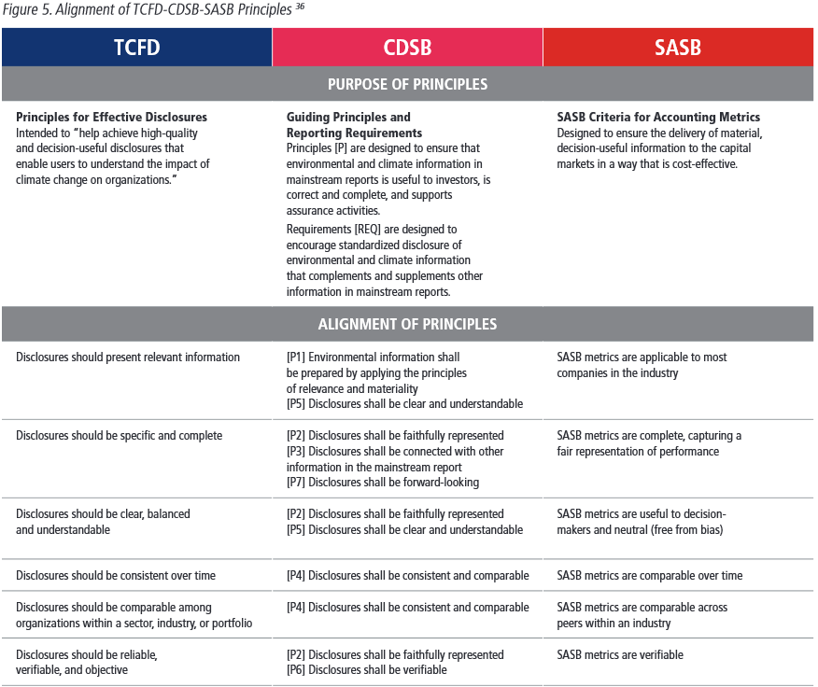
TCFD

Slide 15
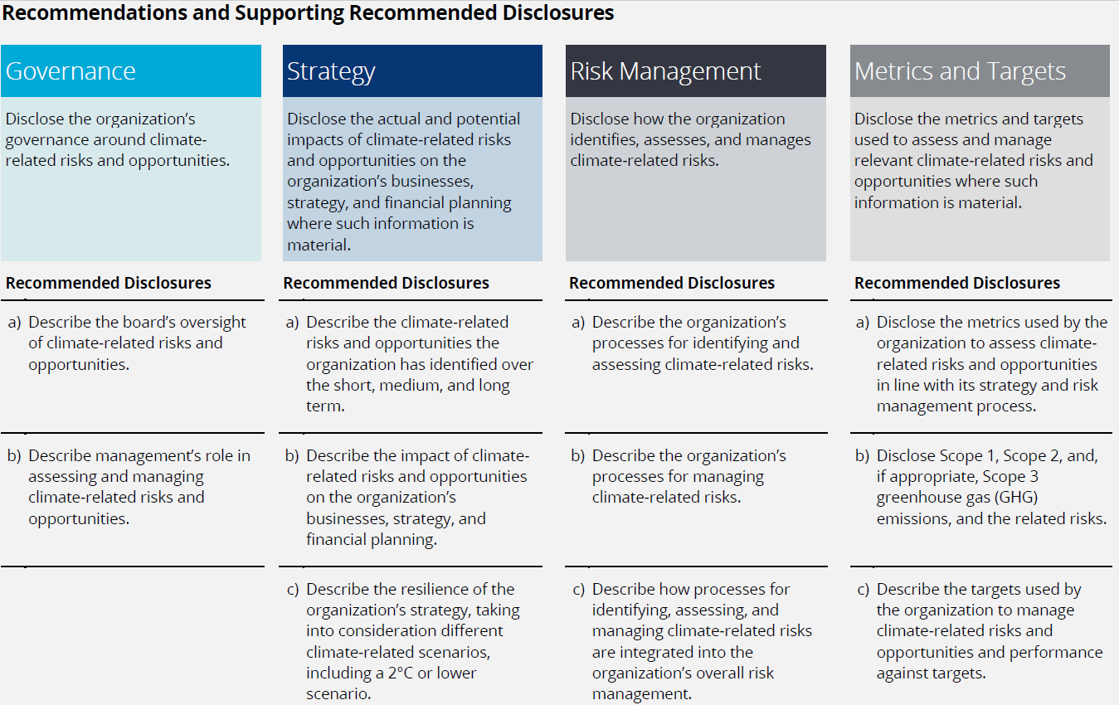
TCFD

Slide 16
General disclosure and KPI
Policies on identification and mitigation of significant climate-related issues with have impacted, and those which may impact the issuer
KPI– description of the significant climate-related issues which have impacted, and those which may impact the issuer and the actions taken to manage them

Slide 17
Social KPI
All become mandatory include:
Work force gender
Employee turnover rate by gender, age, region
Number of accident and days lost
Occupation safety measure
Training and training hours
Labour standard – force labour and child labour
Product responsibility

Slide 18
New social KPI
Supply chain management
Practices relating to engaging suppliers,
Identify environmental and social risk
Description of practices used to promote environmentally preferable products and services

Slide 19
Anti-corruption
Expect to have board training and management training on anti-corruption

